Slide 1
2024 NBRC APPLICATION WORKSHOP SERIES Budgets, Budgets, Budgets!
Northern Border
Regional Commission
Adrianne Harrison, Program Manager: aharrison@nbrc.gov
Marina Bowie, Program Manager: mbowie@nbrc.gov
Notes:
Marina
HIT RECORD!
Welcome and housekeeping items:
First of all, congratulations to you all, as you have officially been invited to submit an application, which means NBRC and state partners valued your project and want to see more!
This is the first in a series of workshops meant to support those invited to apply with the various nuances of the NBRC program application. Today's session will focus on the budget documentation within the application.
Introduce other NBRC staff and State Program Managers who may be on the call
This session will be recorded, and the slides and recording will be made available on the NBRC website. Please keep your microphone muted until the end of this session, at which point we will have plenty of time for questions. You may use the chat function to ask questions along the way.

Slide 2
Topics for today’s session:
Northern Border
Regional Commission
How to Create an Application – quick review and resources
Review budget information that carries into the application
3. Common budget feedback from pre-applications
4. Budget Details – Completing the SF424cbw
Important Costs to Include
5. Finalizing GMS budget information
Budget Categories/Periods Table
Budget Narrative
Funding Sources and Commitments Table
6. Common Budget Errors
7. SF-424 Application for Federal Assistance
Notes:
Marina
Today's session will cover the 5 budget related documents, narrative, tables and forms in the application, including the SF-424cbw detailed budget, the GMS budget categories table, the budget narrative, the funding sources and commitments table, and the SF-424 application for federal assistance. We'll review each budget related item as well as common errors.

Slide 3
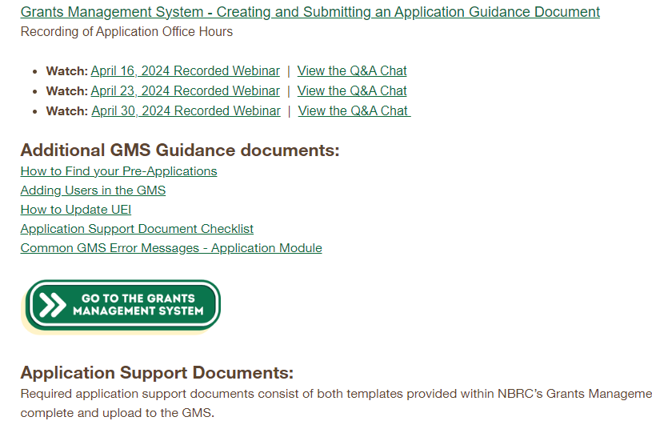
Creating an Application
Northern Border
Regional Commission
RESOURCES:
Grants Management System Resources
Creating and Submitting an Application Guidance Document
Recorded Application Office Hours
Program User Manuals
Catalyst
Forest Economy
Timber for Transit
Notes:
Marina
For the purposes of today’s session, we won’t go into a lot of detail around how to create your application, but we do want to highlight those resources available to you. Our “Creating and Submitting an Application Guidance Document” was updated this morning with clarifications and additional details we felt were necessary based on the spring round. We also have recorded office hours where we helped folks through this process and answered questions.
As with pre-applications, the Program User Manuals will be an important resource as you develop your application. The application portion of the User Manual walks you through each section of the application, with guidance on what we’re looking for.
And, not listed here, but your invitation to apply letter includes feedback from NBRC and our State Partners, (and for FEP, Advisory Board members) around where and how you can strengthen your proposal at time of application. If you have not yet located your invitation to apply letter, you’ll find it in the Collab tab of your GMS application.

Slide 4
Budget Information from Pre-Application
Northern Border
Regional Commission
High quality budget information helps NBRC understand how funds will be used and how costs are estimated.
Budget information that was created in the pre-application will carry forward to the application Budget tab:
Budget Categories/Periods Table
Budget Narrative
Funding Sources and Commitments Table
Pro Tip: First, review Invitation to Apply for requested budget revisions.
Notes:
Marina
Shifting our focus to budgets - It’s important to point out that at the application stage, you’re not starting from scratch. Much of the information you submitted at pre-application will carry forward. In terms of budget items, the Budget Categories/budget periods table, budget narrative, and funding sources and commitments table will all be pre-populated within the application.
New items at application include the SF424cbw, the SF424 application for federal assistance, and the funding sources and commitments table becomes a required field.
Once again, please locate your invitation to apply letter from NBRC and review the feedback presented. Where applicable, invitations included feedback related to budget items.

Slide 5
Common Budget Feedback
Northern Border
Regional Commission
View Invitation to Apply for requested budget revisions, for example:
Inadequate Budget Narrative.
No Funding Sources listed.
Exceed Maximum Award.
No construction costs.
Other Federal Funds.
Review match rate.
Pro Tip: Complete the SF-424cbw Budget Details before editing the GMS budget section. A complete and correct SF-424cbw makes updating the GMS budget information easier.
Notes:
Marina
Common budget feedback you may find in your invitation to apply includes the bulleted items here, with additional context with each. We’ll walk through each of these pieces of feedback within today’s presentation, but as a quick overview, if your budget narrative did not include sufficient detail or if you did not provide a list of match funding sources, you will see that reflected in the feedback. If based on our review, we determined the project was not eligible for a higher maximum award, or for Catalyst specifically, if the project did not meet the criteria for an infrastructure level award, you will see the flag that the request exceeded the maximum award and qualifies as non-infrastructure. If your project appears to qualify as infrastructure, but there were no construction costs listed, you’ll need to provide construction costs within the budget at time of application.
If your project included other federal funds, we have flagged the federal funds limitation, which is that no more than 80% of the total project cost can be covered by federal funding, including the NBRC award.
If we found that your match was incorrect or needs additional review, we’ve flagged that as well.
As you’re developing your application, we recommend completing the SF-424cbw first! This is a required form at time of application, and once you have finalized your SF-424cbw, it should be really simple to go into the GMS and update all of your other budget information – budget narrative, budget categories table, and funding and commitments table, to ensure that all budget items are in alignment. We will be looking for this in our review.
Pass to Adrianne for a detailed review of the SF-424cbw.

Slide 6
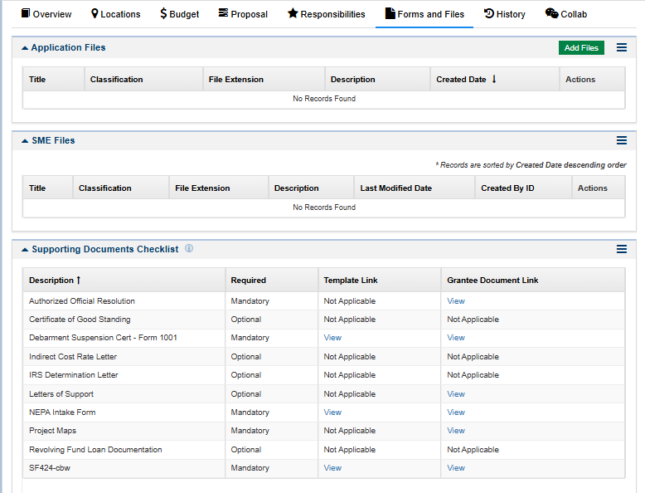
Completing the SF-424cbw
Northern Border
Regional Commission
The SF-424cbw is available in the Supporting Documents Checklist
Download, complete, and upload back to the Supporting Documents Checklist
A copy is available on the NBRC website here
Notes:
Adrianne
The SF-424cbw is available in the Supporting Documents Checklist under the Forms and Files tab of the Grants Management System
Download, complete, and upload back to the Supporting Documents Checklist. Do not upload to the Application Files section.
You can also find a copy on the NBRC website if needed.

Slide 7
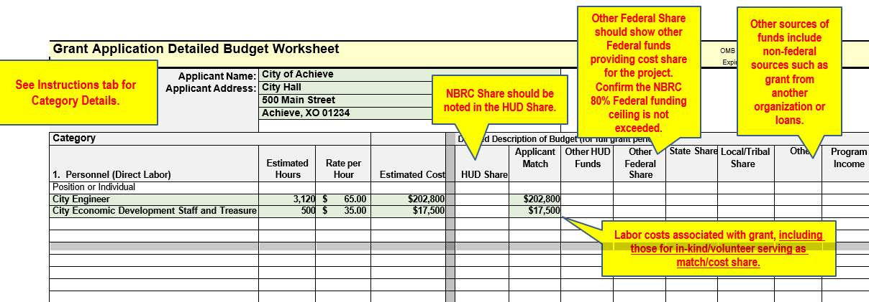
Completing the SF-424cbw
Northern Border
Regional Commission
A sample SF 424-cbw is available NBRC's resources page, here.
Use the Instructions tab of the SF-424cbw for guidance on the types of costs in each category
Notes:
Adrianne
A sample SF 424-cbw is available on the resources page of the NBRC website, here.
The next few slides will highlight tips in the sample.
The first – please complete the Applicant Name section at the top.
If you are not familiar with this budget form, here are a few items to note:
Estimated costs column is where you enter the total estimate cost for each line item. The totals for each category will auto populate based on each line item. Note that the estimated costs will not change based on what you enter in the columns that allocate costs. So you need to make sure the amounts you list in columns G-O add up to the estimated costs.
Columns G-O are where you allocate the share for each of the line item costs. The column labeled “HUD Share” is where you enter the “NBRC Share”. This is a form we borrow from HUD. Applicant Match is where you enter the amount coming from the applicant organization. You can use the other columns to show contribution from Other Federal sources, State sources, Local/tribe sources, and Other sources. The sum of all the contributions should be equal to the estimated costs.
In the SF-424cbw form itself you’ll also see an Instructions tab. The instructions tab has guidance for what type of costs go in each category.

Slide 8
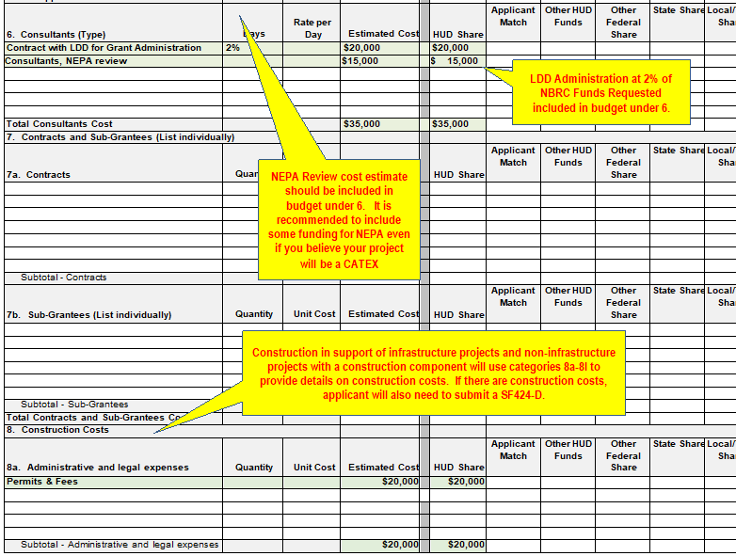
Northern Border
Regional Commission
The SF-424cbw categories are the same as the GMS budget table categories.
Include descriptions for costs in each category. Without descriptions in the category column, it’s difficult for the reviewer to determine how funds will be spent. Do not leave this column blank!
If applicable, add LDD Grant Administration costs as a line item in Category 6 Consultants. The costs should be equal to 2% of the NBRC requested amount.
Notes:
Adrianne
The categories in the SF-424cbw correspond with the categories in the GMS Budget Periods Table.
For each cost, please include a line item description.
Category 6 is the category for Consultants. Please use this category to list contracts for LDD Grant Administration Services. You’ll see in the sample, there is a line item description that clearly identifies the LDD costs. The formula is 2% of the NBRC requested amount. You can choose to put the entire LDD costs in the NBRC share column or split out the costs between NBRC and another share column.

Slide 9
Completing the SF-424cbw
Northern Border
Regional Commission
Add NEPA costs as a line item in the SF-424cbw detailed budget document. These costs should be clearly identified in Category 6, Consultants. The costs should range from $500-$10,000+ depending on the expected level of review or actions to complete the environmental review process.
CATEX | CATEX + Section 106 | Environmental Assessment
Brief review, no public comment period | Required Section 106 review for historic or eligible structures | Robust review
<1 month to develop | 2-6 months depending on consultation | 6-12+ months
$0-$500+ | ~$500-$1,500 | ~$5,000-$10,000+
Questions about NEPA? Refer to NBRC’s NEPA resources page: https://www.nbrc.gov/content/NEPA
Notes:
Adrianne
Category 6 is also the place to include NEPA costs. It is recommended that all projects include a line in the budget for NEPA.
We have provided some rough guidance based on experience.
If you expect your project will fall into a Categorical Exclusion and not require any consultations for historic resources or listed species, you can budget $0. We Please include a line in the budget that says “NEPA costs expected to be $0”. If you are unsure, we recommend you budget a minimum of $500.
If your project will likely fall into a Categorical Exclusion but may also require a consultation for historic resources or listed species, you will want to include a budget to support the consultation process and to satisfy any requests from the Historic Preservation Office or resource agency. We recommend $500-$1500.
If your project is expected to be an Environmental Assessment, the information gathering and review process is more significant. A general estimate is $5000-$10,000. But costs for complex projects can go higher.

Slide 10
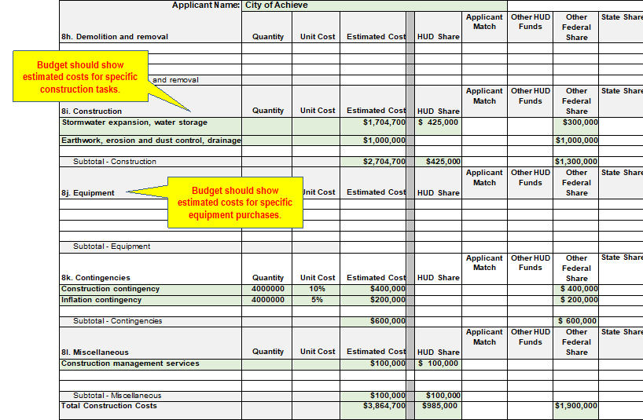
Northern Border
Regional Commission
Construction Costs are represented in Category 8
Include descriptions for each line item that connect the project tasks to the budget.
Infrastructure projects must have construction costs.
"No Construction Costs" feedback in your invitation to apply refers to this requirement.
Notes:
Adrianne
All costs related to construction activities should be represented in Category 8 of the budget.
Please include a description for each line item that helps reviewers identify the project tasks. For example, construction of a water storage tank should have a line item related to the water storage tank costs, the site work that is required, etc.
Infrastructure projects are required to have construction costs to be eligible in that category. If your invitation to apply included “No construction costs”, this means there were no costs identified in the that budget category. Please review your budget for construction costs and include them in category 8.

Slide 11
Reviewing the SF-424cbw
Northern Border
Regional Commission
Review the completed SF-424cbw for common issues and errors:
Each line item cost has a description
Estimated costs are equal to sum of contributions from all shares
Total of NBRC Share (Column G) matches the NBRC requested amount and does not exceed the amount your project is eligible for
NBRC Share + Other Federal Funds (Column G+K) does not exceed 80% of the total project costs.
Projects in distressed counties must meet a minimum 20% match and the 80% Federal Cap
Row and column totals need to match information provided in the Budget Periods Table, Funding Sources Table and the SF-424. Tip: Use the SF424cbw Summary tab to easily view totals.
Notes:
Adrianne
Here are a few common issues to consider when reviewing your completed SF-424cbw:
Each line item cost has a description
Estimated costs (Column E) are equal to the sum of contributions from all the share columns (Columns G-O)
Total of NBRC Share (Column G) matches the NBRC requested amount in your application and does not exceed the amount your project is eligible for. If you received “exceeds maximum award size” as feedback in your invitation to apply, you’ll want to review the NBRC Share total.
The NBRC Share + the Other Federal Funds column should not be more than 80% of the total project costs. If the total of those 2 columns is more than 80%, you have exceeded the federal funding ceiling. You will receive an error message with the Budget Periods Table in the GMS if these totals exceed 80%. If you received “Other Federal Funds” as feedback in your invitation to apply, you’ll want to ensure the total of all federal funds do not exceed 80%. Congressional Directed Spending (CDS) and American Rescue Plan Act (ARPA) funds are common funding sources that are considered federal funds.
Consider using the SF424cbw Summary tab to quickly view the category totals. The Column totals and Row totals need to match the information provided in the Budget Periods Table, Funding Sources and Commitments Table, and the SF-424 Application for Federal Assistance form. If awarded funds and these totals do not match, NBRC will need to request revisions to your application.

Slide 12
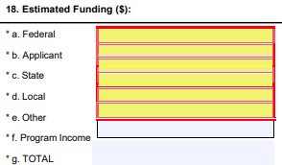
SF-424 Application for Federal Assistance
Northern Border
Regional Commission
Form is built into the GMS
Must be signed by the Authorized Official (single individual listed in the AO Resolution)
Common errors: federal amount should include NBRC requested amount and other federal amount; total project costs should match Budget Periods Table and SF-424cbw budget details
SF-424 Sample with Instructions available here.
Notes:
Adrianne
We will review this form more completely in the 3rd application workshop focused on forms and files, however, I did want to point out one common budget related issue we see in this form.
The Federal amount in box 18a of this form should be the total of NBRC Share and the Other Federal Funds column. The other elements align well with the SF-42cbw share columns.

Slide 13
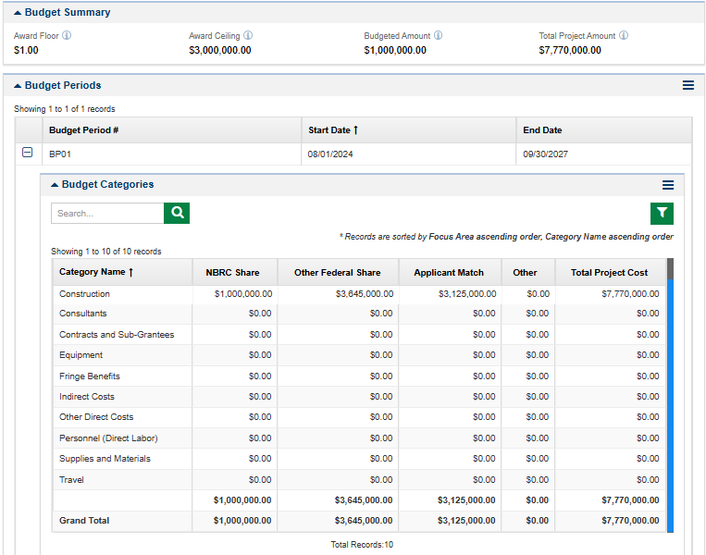
Budget Table
Northern Border
Regional Commission
Notes:
Marina
Moving our attention to the budget table. This is the table you have filled out for pre-applications within the GMS. This information will be pre-populated with the information you submitted at pre-application, so it may need to be updated based on more accurate cost estimates and feedback from NBRC. The categories listed in the budget table mirror the SF-424cbw.

Slide 14
Budget Table
Northern Border
Regional Commission
Budget Table will be used throughout the life of the project to track budget categories:
Critical application element for showing how funds will be used
Revise budget categories based on new estimates, more detailed data, or corrections requested in the pre-application.
Must align with other budget information: Funding Sources table, SF-424cbw Budget Details, and SF424 Application for Federal Assistance
Carried forward from preapplication – edit as needed
Notes:
Marina
Once you have finalized the SF-424cbw, you’ll want to make sure the values listed in the budget table in the Grants Management System matches the values listed in the SF-424cbw.At time of application, we understand you may have more detailed and accurate cost estimates, and those should be reflected in all budget pieces. From a reviewer standpoint, we will be looking for the request amount and match funding to exactly match the total in the budget table and SF-424cbw, and SF-424 appf or federal assistance, as well as for all of the category totals to match.

Slide 15
Budget Table
Northern Border
Regional Commission
Budget Table Reminders:
80% Federal Funding Ceiling – calculated on total project costs
Applicant minimum required match – calculated on NBRC requested amount
ARPA funds considered federal source; CDBG and loans are not considered a federal source
Notes:
Marina

Slide 16
Budget Narrative
Northern Border
Regional Commission
A high-quality budget narrative will clarify the connection between the costs and the proposed project.
Explain and justify costs above $5,000
Describe how the cost estimate was determined and where possible, reference sources for cost estimates
Provide a breakdown of expenses that make up each budget category total
For contracts and service quotes, please note that if awarded funding, you will be required to comply with federal procurement guidelines
See the NBRC Compliance Manual for more information and procurement requirements.
Carried forward from preapplication – edit as needed
Notes:
Marina
The Budget Narrative is used to describe and justify the costs listed in the Budget Periods table and should provide enough information to understand how NBRC funds will be spent. All expenses over $5,0000 must be listed with a description of the cost and an explanation of how the cost was determined. Please clarify which parts of your budget are estimates, based on quotes or fixed price.
Like all of these budget pieces, the budget narrative should be supportive of and consistent with the budget periods table.

Slide 17
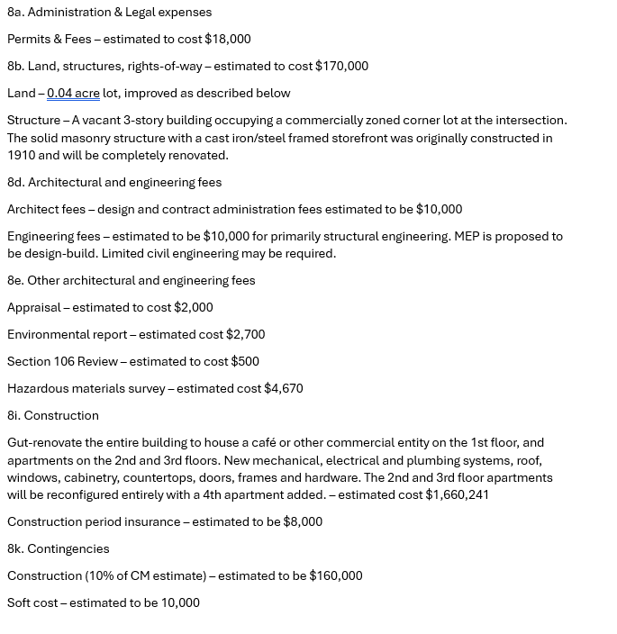
Budget Narrative
CONSTRUCTION EXAMPLE:
Describe and break out large cost categories
Help reviewer understand what funds will be used for
In the corresponding SF-424cbw:
Category 6 is the place to identify NEPA and any specific expected review costs such as Section 106 historical review
Category 6 is the place to identify the LDD costs and LDD you expect to work with
Notes:
Marina
Here we have provided an example of a well constructed budget narrative. This snapshot lists out the construction costs for the project and is organized by the category #’s in the SF424cbw. It’s easy to follow, and where possible, they’ve even drawn references to the cost estimates – where they came from and how they were developed. This budget narrative provides additional clarification related to the work to be completed for the project. This example shows the NEPA costs and LDD costs listed within section 8 of the SF-424cbw, but please note that we have requested NEPA estimates and LDD costs be listed in Category 6 of the SF424cbw.

Slide 18
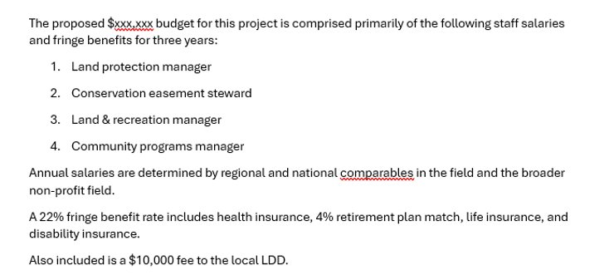
Budget Narrative
Northern Border
Regional Commission
PROGRAM EXAMPLE:
Describe and break out large cost categories
Help reviewer understand what funds will be used for
Share how costs were determined such as comparable salaries
Make connection between budget category number on SF-424cbw
Notes:
Marina
Here is another example of a budget narrative, this one is for a non-construction project. The applicant broke out large cost categories, in this instance staff salaries and fringe, to show how they came up with the overall cost, and how salaries were determined. Again, it’s always helpful to draw specific connections to the line items in the SF424cbw. For the budget narrative, please note that you will be limited to 5,000 characters.

Slide 19
Funding Sources Table
Northern Border
Regional Commission
Carried forward from preapplication – edit as needed
Notes:
Adrianne
The funding sources and commitments table is the final budget piece to complete. The table is located at the end of the Budget tab screen, below the narrative.
A complete table is required with the application. If you received “No funding Sources listed” as feedback in your invitation to apply, it means that this table was not completed with the pre-application. You will receive an error message if you submit the application without complete and accurate funding sources table.

Slide 20
Funding Sources Table
Northern Border
Regional Commission
This table is only for sources of match and cost share.
Do not include NBRC request amount
Funding sources and commitments table must be complete with the minimum required match
All match sources should be identified, with a plan for securing all required match and cost share within one year of award receipt.
While not required, it can be helpful to include letters of support and/or letters of commitment for match and cost share sources
Notes:
Adrianne
The purpose of this table is to share the sources and status of funds that will be used as match or cost share to complete the project.
You should not include the NBRC share/requested amount in the funding sources table.
The table will validate that the sources listed meet the minimum match requirement and that the total non-NBRC required funding for the project has been identified. You will want to ensure that the total of the funding sources table matches exactly the total of Applicant Match, Other Federal and Other columns in the Budget Periods Table. You will receive an error message if these amounts do not match.
All match source should be identified. If you do not know a source of some funds, you will need to include a line item that says Unknown or TBD. A reminder that NBRC requires all match and cost share to be committed within 1 year of the award. This is a requirement of the Notice to Proceed.
It is not required, but it can be helpful to secure letters of support from certain entities providing match and cost share for the project such as local businesses.

Slide 21
Completing the Funding Sources Table
Northern Border
Regional Commission
For each source:
Add a line for each source of match and cost share
Provide where the funds are coming from in the “funding source”
Type of funding – Local, Federal, Non-Federal, etc.
$ Amount
Date of Commitment, Secured/Pending
Status is used to describe where you are in the process of securing the funds: Secured (or received/committed), Pending (or applied for), Identified (or not yet applied for), or Ongoing (or fundraising)
The total amount identified in the Funding Sources table will be verified against the total match and cost share in the Budget period table
Notes:
Adrianne
Type of funding: Congressional Directed Spending (CDS) and American Rescue Plan Act (ARPA) funds are common funding sources that are considered federal funds. CDBG and federal loans are not considered federal funds.

Slide 22
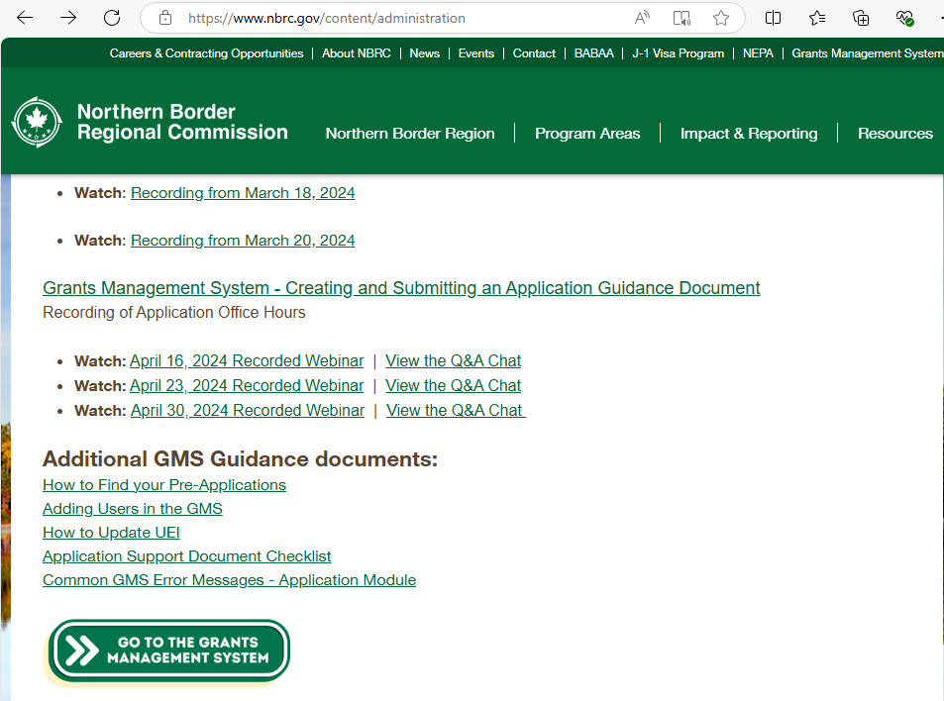
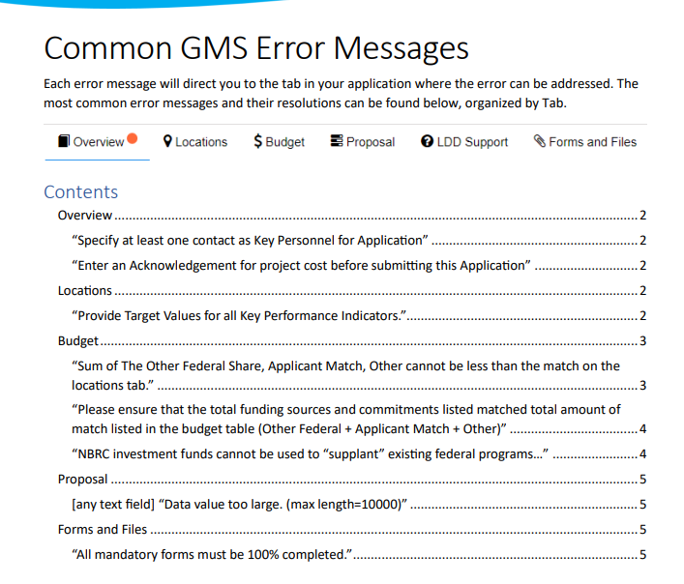
Common Budget Errors
Northern Border
Regional Commission
If you encounter an error when submitting your application, you can find the answer to common budget errors in our GMS errors resource
Notes:
Adrianne

Slide 23
Budget Evaluation
Northern Border
Regional Commission
Budget Evaluation:
All budget components (Budget Table, Budget Narrative, SF-424cbw and Funding Sources table) contribute to NBRC Scoring Criteria #2 - Project Costs & Match
Budgets are an important component for reviewers to evaluate the project and understand the investment.
A well developed and detailed budget can help clarify project activities
Notes:
Marina
All Programs: Budgets and costs, including contingency for construction projects, are clear and reasonable. Project costs and match are clearly outlined. Project costs should include a detailed project budget that aligns with the project description. Project budget shows detailed costs and relevant cost estimates. Project timeline is feasible and supports timely project completion. Applicants must identify sources of match in the budget and detailed budget narrative. Applicants may provide or be asked to provide letters of commitment/support to confirm stated match contributions. Leveraged funds in addition to required match should also be described if applicable. Budget narrative should be aligned with the project description, provide brief justification for expenses over $5,000, and if requesting the higher maximum for an infrastructure project, describe how the requested funds will be allocated across infrastructure categories.

Slide 24
QUESTIONS?
Northern Border
Regional Commission
RESOURCES:
Program User Manuals, GMS Application Guidance, GMS Application recorded office hours, SF-424cbw sample, SF-424 Sample, GMS Errors Resource, NBRC NEPA page, Program FAQs,
Other? Email admin@nbrc.gov

